Slide 1
Loading an ASCII file

Slide 2
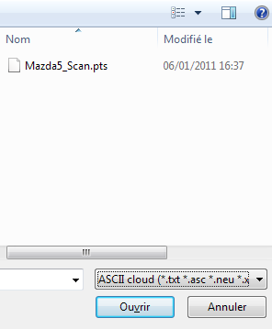
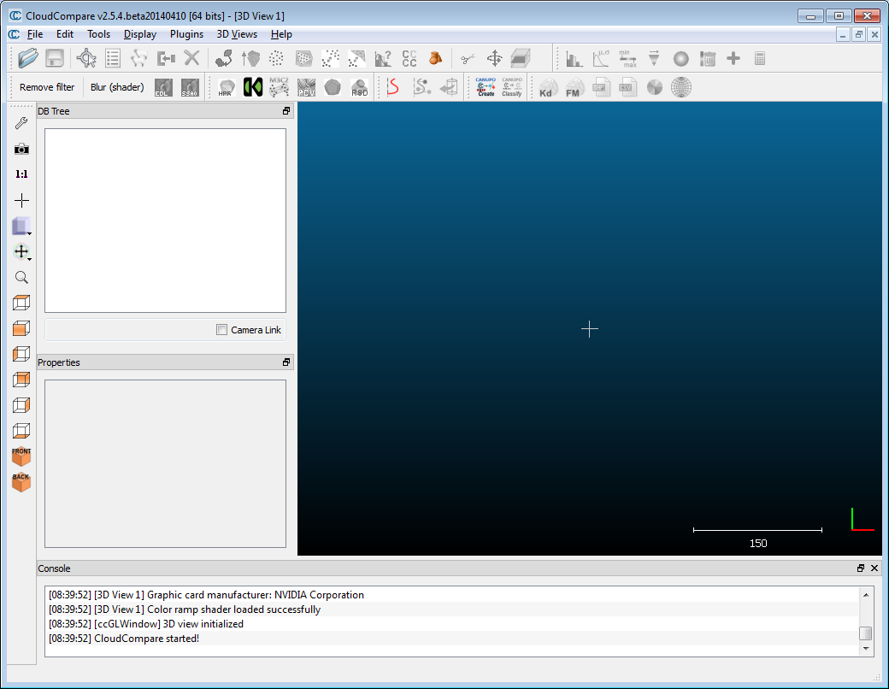
Loading a file (ASCII)
File > Open
file: Mazda5_Scan.pts

Slide 3
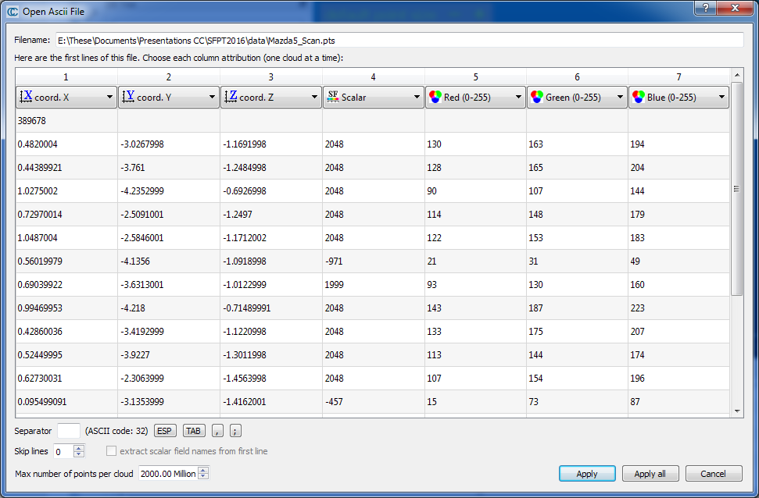
Loading a file (ASCII)
Assigning a role to each column

Slide 4
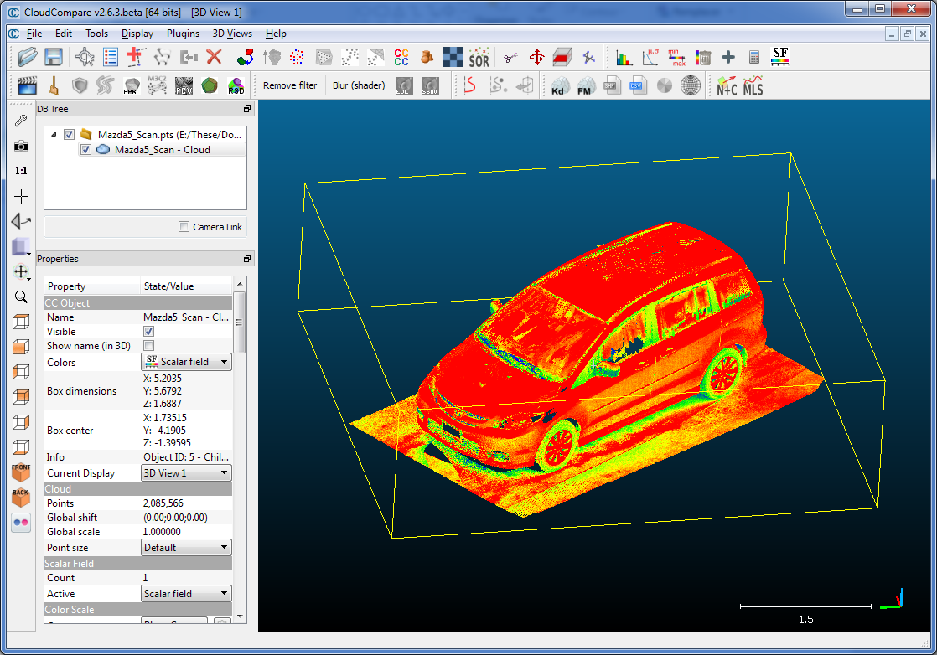
Loading a file (ASCII)

